Slide 1
02 | Introduction to Express Framework
Stacey Mulcahy | Technical Evangelist
Rami Sayar | Technical Evangelist

Slide 2
Module Overview
What is Express
Installing & Using Express
Demo: Creating a simple Rest API
Templating

Slide 3
02 | What is Express
Stacey Mulcahy | Technical Evangelist
Rami Sayar | Technical Evangelist

Slide 4
What is Express?
Express is a minimal, open source and flexible node.js web app framework designed to make developing websites, web apps and APIs much easier.

Slide 5
Why use Express?
Express helps you respond to requests with route support so that you may write responses to specific URLs.
Supports multiple templating engines to simplify generating HTML.

Slide 6
02 | Installing and Using Express
Stacey Mulcahy | Technical Evangelist
Rami Sayar | Technical Evangelist

Slide 7
Installing and Using Express
npm install express
npm install jade

Slide 8
02 | Creating a Simple Rest API
Stacey Mulcahy | Technical Evangelist
Rami Sayar | Technical Evangelist

Slide 9
Explanation of Routes
A router maps HTTP requests to a callback.
HTTP requests can be sent as GET/POST/PUT/DELETE, etc.
URLs describe the location targeted.
Node helps you map a HTTP GET request like:
http://localhost:8888/index
To a request handler (callback)
app.get('/index', function (req, res) {});

Slide 10
Creating a Simple Express Application
var express = require('express');
var app = express();
app.get('/', function (req, res) {
res.json({message:'hooray! welcome to our api!'});
});
app.listen(process.env.PORT || 8080);

Slide 11
Creating a simple Rest API with Express Framework

Slide 12
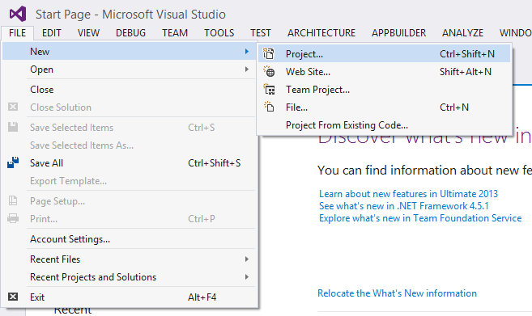
Why use Express?

Slide 13
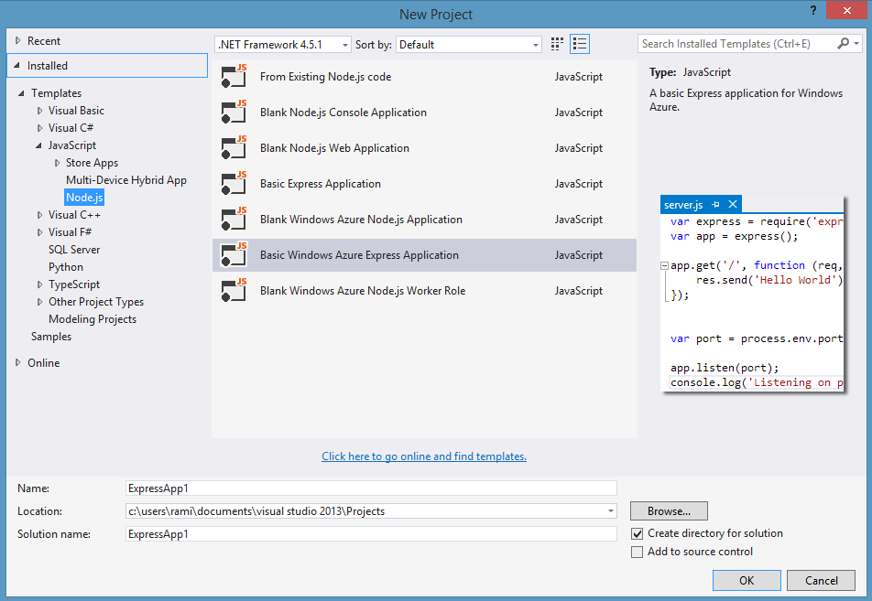
Why use Express?

Slide 14
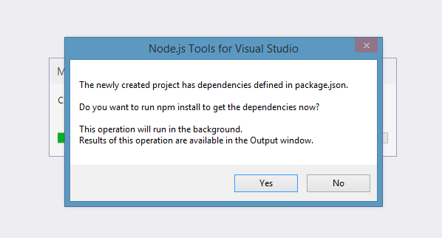
Why use Express?

Slide 15
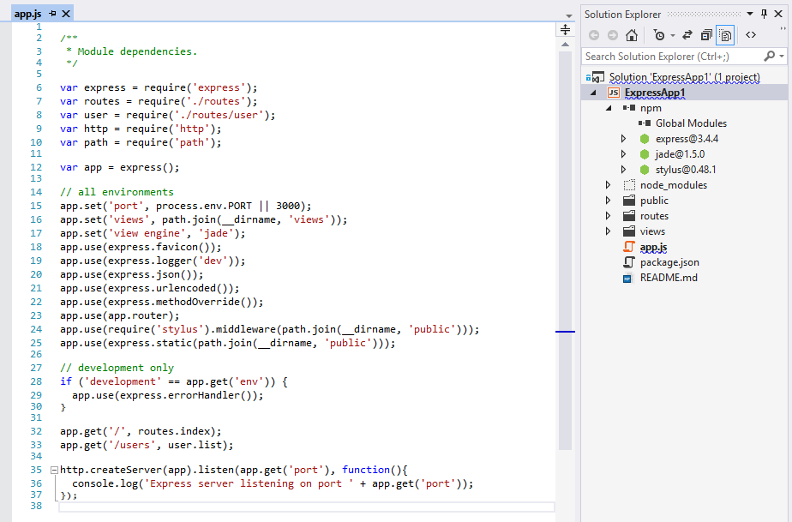
Why use Express?

Slide 16
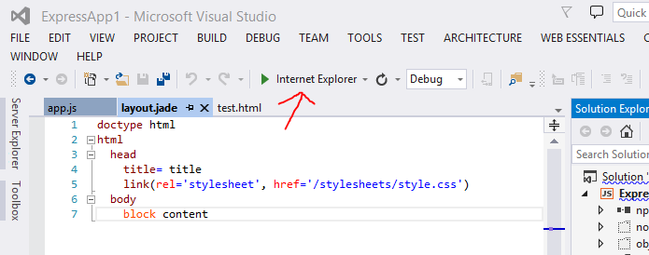
Why use Express?

Slide 17
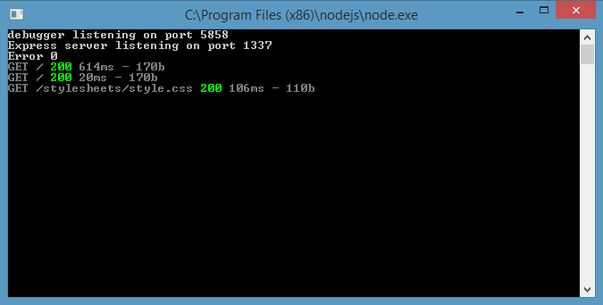
Why use Express?

Slide 18
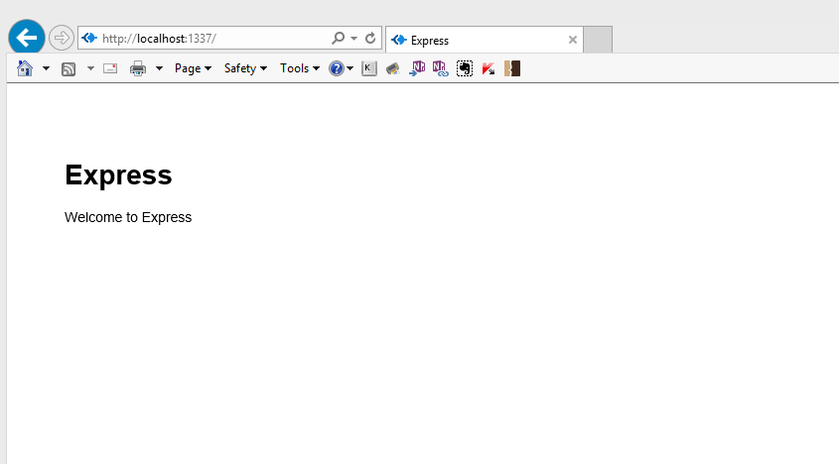
Why use Express?

Slide 19
Resources
Express Framework http://expressjs.com/
Intro to Express http://code.tutsplus.com/tutorials/introduction-to-express--net-33367
Jade Templates http://jade-lang.com/tutorial/
JavaScript and Jade Templating http://www.slideshare.net/wearefractal/jade-javascript-templating

